Slide 1


x86-64 Assembly and ELF
Notes:
https://www.flickr.com/photos/looksgood/26261252551/in/album-72157616680829287/

Slide 2
x86-64 Assembly

Slide 3

History
Originally AMD64
Created as an alternative to Intel’s IA-64 by AMD
Extended the existing x86 architecture to preserve backwards compatibility
Intel’s IA-64 was a completely new architecture
Originally performance on IA-64 for IA-32 code performed poorly (worse than original IA-32 applications)
Software emulator was created to establish better performance
Processors that support this architecture will cease production on July 29, 2021
Later renamed to x86-64
Notes:
https://en.wikipedia.org/wiki/X86-64
https://en.wikipedia.org/wiki/IA-64

Slide 4
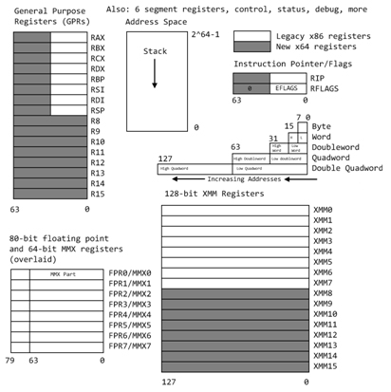
x86-64 Features
Expands general-purpose registers
32-bits to 64-bits
8 registers to 16
Full backwards compatibility with 32-bit compiled code
64-bit max theoretical address space
As of right now supports 2⁴⁸ bytes (256 TiB) of RAM
Can be extended to 2⁵² and in theory could be extended to 2⁶⁴ (16 EiB)
No-Execute bit
Allows the OS to specify which pages of address space can contain executable code and which cannot
We will come back to this during binary exploitation
Compilers start using different calling conventions

Slide 5
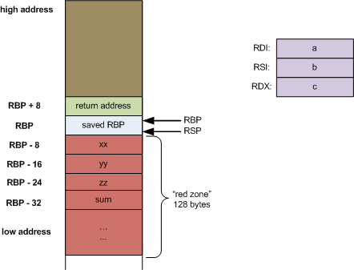
System V AMD64
Solaris, Linux, FreeBSD, macOS
First six arguments are passed via registers:
Integer, struct, pointer arguments: RDI, RSI, RDX, RCX, R8, R9
Floating Point Arguments: XMM0, XMM1, XMM2, XMM3, XMM4, XMM5, XMM6, XMM7
Additional arguments passed via the stack
Returns
Integer: RDX:RAX
Floating Point Arguments: XMM1:XMM0
RBX, RSP, RBP, R12- R15 need to be backed up by the callee (non-volatile)
The caller is expected to back up all other registers if the values should be retained (volatile)
Leaf-node functions (functions that do not call other functions)
Have a 128-byte space beneath the stack pointer called the red zone
It can be safely assumed that the compiler has free reign over this entire space without it being clobbered
Notes:
https://eli.thegreenplace.net/2011/09/06/stack-frame-layout-on-x86-64

Slide 6
Microsoft x64
First four arguments passed via registers:
Integer, struct, pointer arguments: RCX, RDX, R8, R9
Floating Point Arguments: XMM0, XMM1, XMM2, XMM3
Additional arguments are passed via the stack
Returns
Integer: RAX
Floating Point: XMM0
RAX, RCX, RDX, R8-R11 are considered volatile (caller-saved)
RBX, RBP, RDI, RSI, RSP, R12-R15 are considered non-volatile (callee-saved)
No Red Zone

Slide 7
Executable and Linkable Format

Slide 8
Background
File format for executable files, object code and shared libraries
Published for System V
Quickly accepted as the standard binary file format for Unix and Unix-like systems

Slide 9
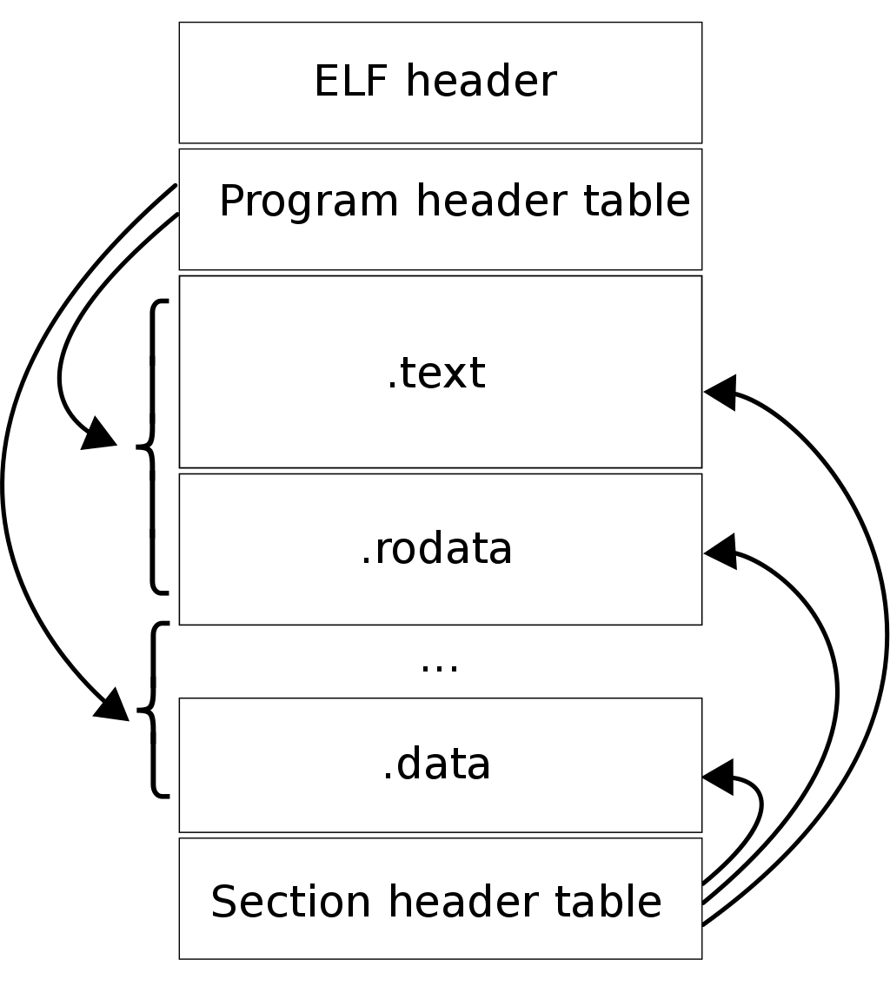
Layout
File Header
Defines metadata about the program
Program Header (or Segments)
Tells the system how to create the process
ELF contains 0 or more segments
A segment consist of 0 or more sections
Section Header Table
Entries contain metadata about a given section
Optional on executable, used for linking and relocation
Sections
ELF contains 0 or more sections
.text: executable code
.data: initialized read/write data
.rodata: read only data
.bss: uninitialized read/write data

Slide 10
Sections vs Segments
Sections are intended to provide a view for the linker only
Optional
Not required if the file doesn’t need linking
To load and execute a binary segments are used

